Slide 1
Recreational Drugs and Police Data

Slide 2
Team Name:
No Free Lunch

Slide 3
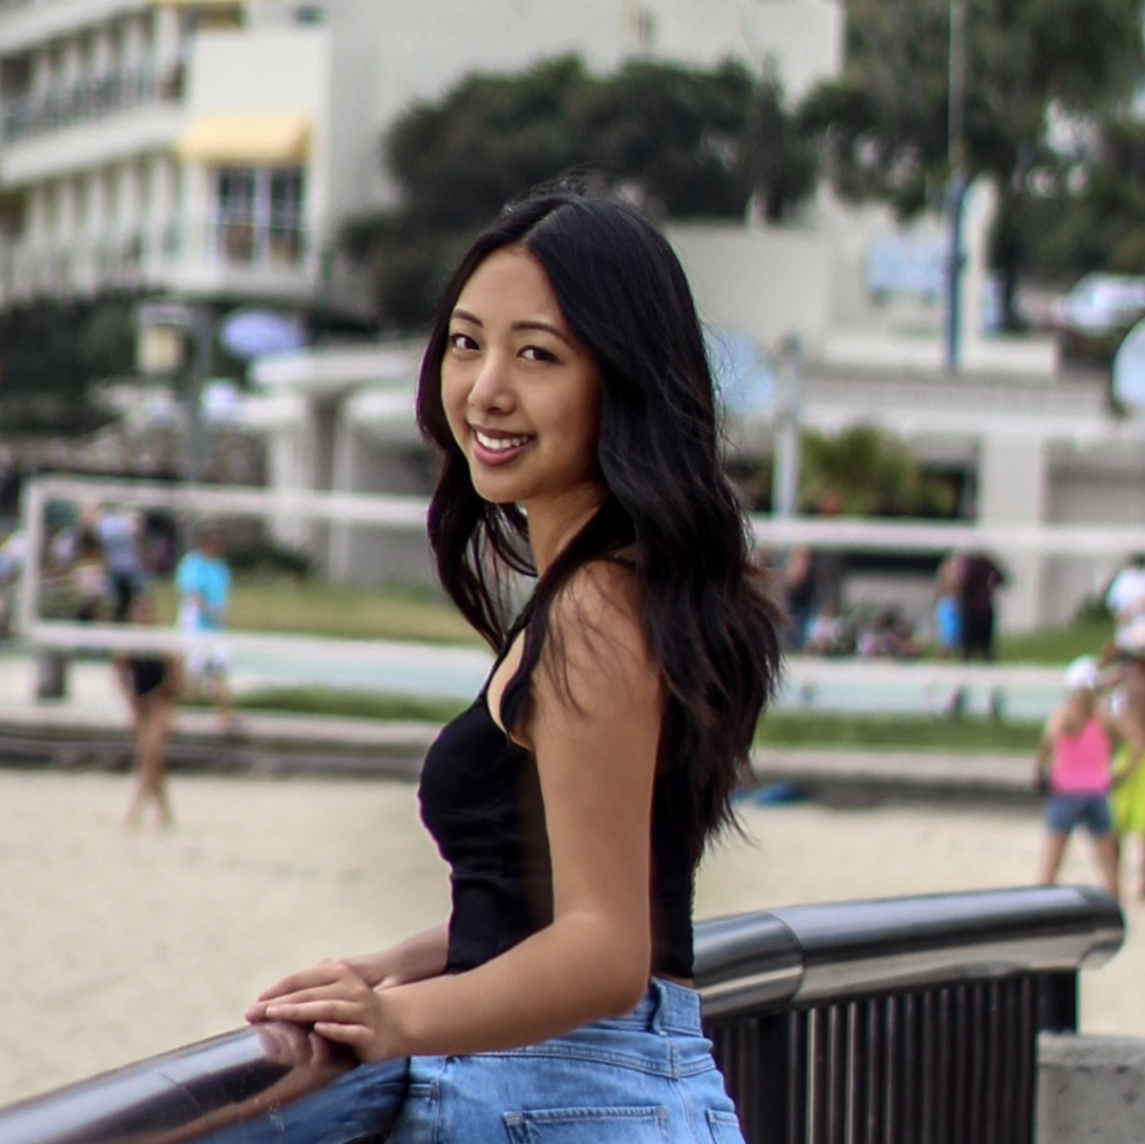


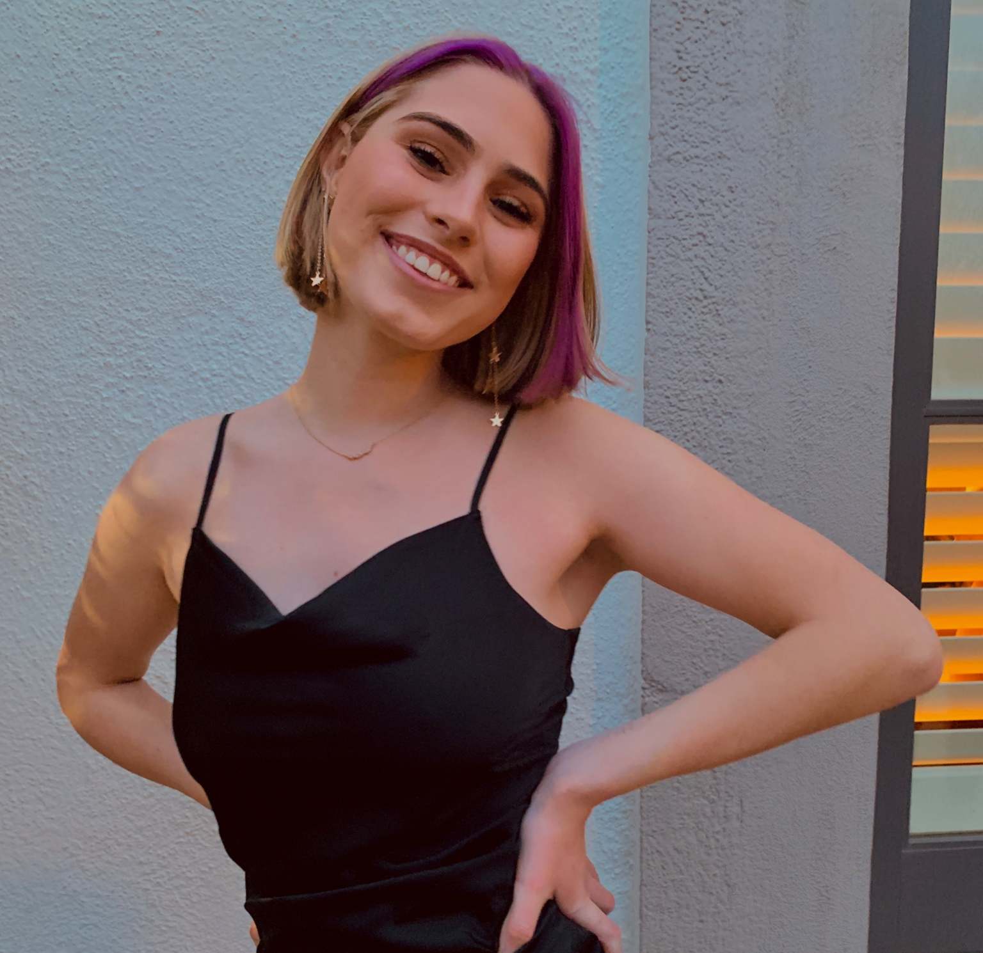

Team Members
Cassandra Man
manc@usc.edu
Wilson Ho
wilsonho@usc.edu
Yilin Qi
yilinqi@usc.edu
Tara Erberich
terberic@usc.edu
Amy Zhang
amyzhang@usc.edu

Slide 4
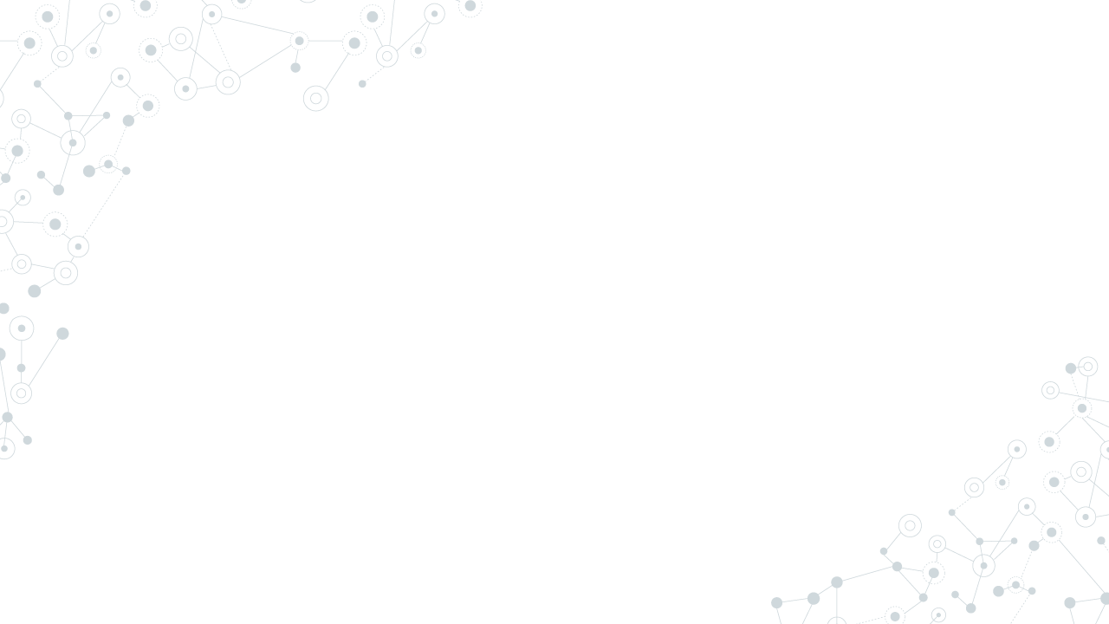
Research Questions
How does non-medical drug usage correlate with police density by state for different drugs?
Ex: non-medical drug usage of different drugs vary with police density.
What policing variables predict drug use (police density, drug arrests made) of different drugs?
Ex: Are certain drug usages more sensitive to police density, others more sensitive to arrests made.

Slide 5
Methods
Clean Data & normalize data by mean, find external policing data, calculate per capita of arrests and police density, and combine selected variables
Create scatter plots with regression models for visualization and run summary stats to find significant and nonsignificant p-values
Create scatter plots for lowess models to visualize any nonlinearity and to check different smoothing fractions
1
3
5
2
4
6
Ran Regression on all drug variables against police per capita and against drug arrests per capita
Run Lowess Smoothing to check for nonlinearity on all drug variables against police per capita and against drug arrests per capita
Create Choropleth Maps to visualize all drug variables, police per capita, and drug arrests per capita by states

Slide 6
Final Variables Analyzed
BENZ_NMU_EVER
GABA_NMU_EVER
dem_state
ILL_USE
OP_NMU_EVER
STIM_NMU_EVER
External Variables:
police_per_capita
drug_abuse_arrests_PerCapita

Slide 7
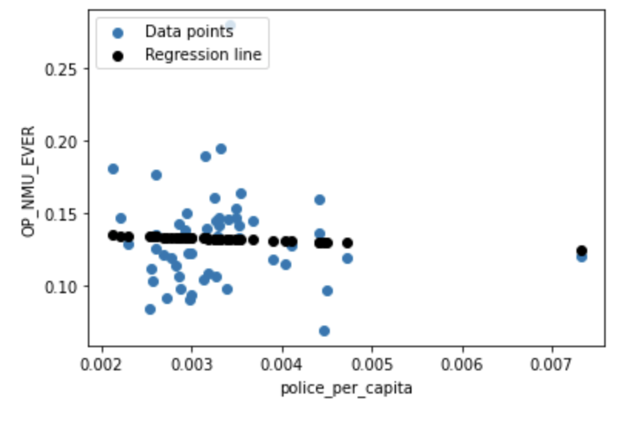
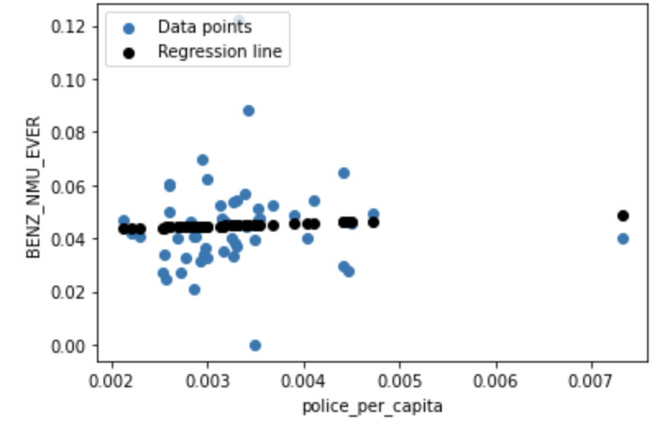
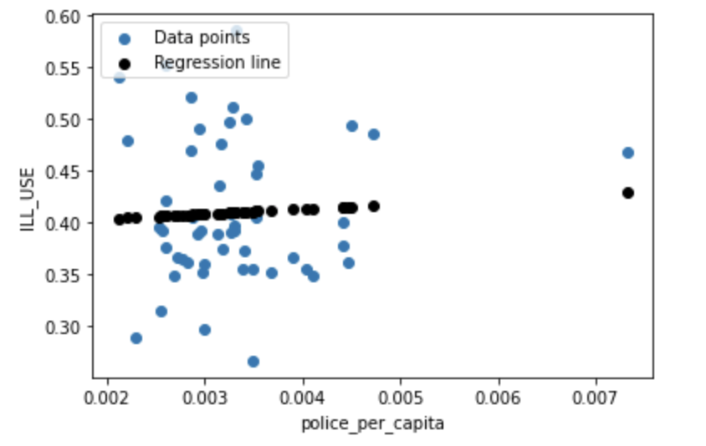
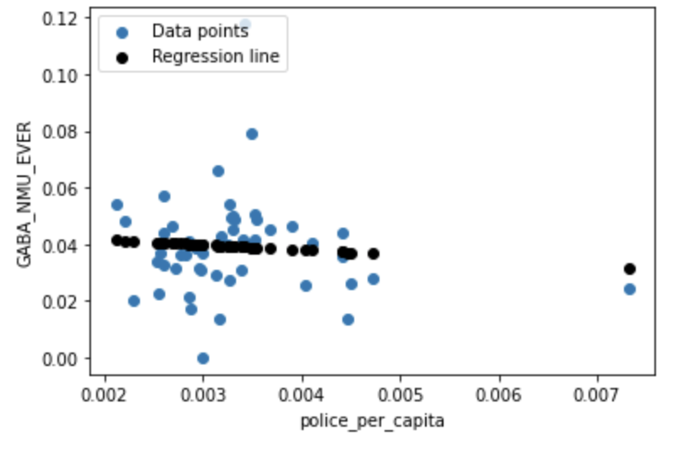
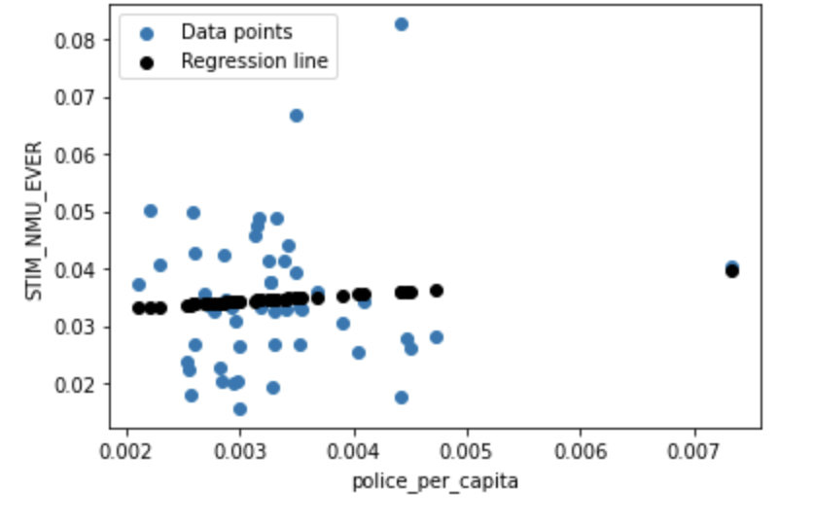
Regression Models for Police Per Capita VS Drugs
No significant p-values at alpha level 0.05

Slide 8
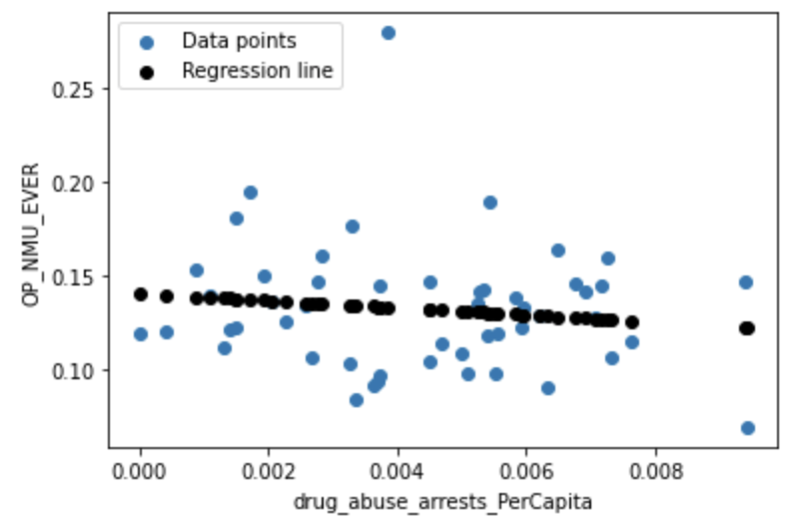
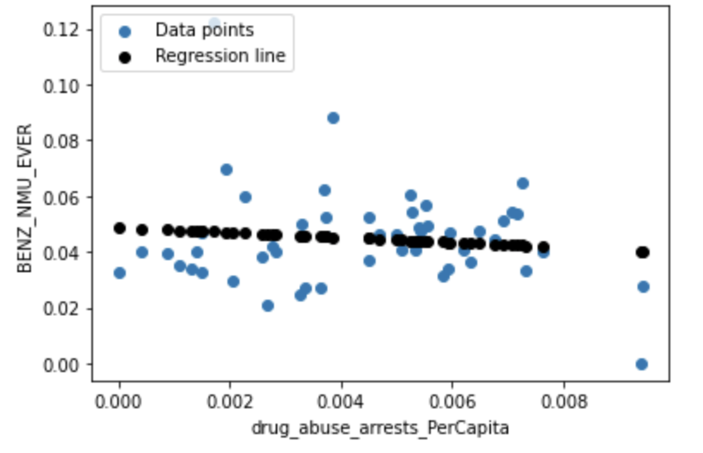
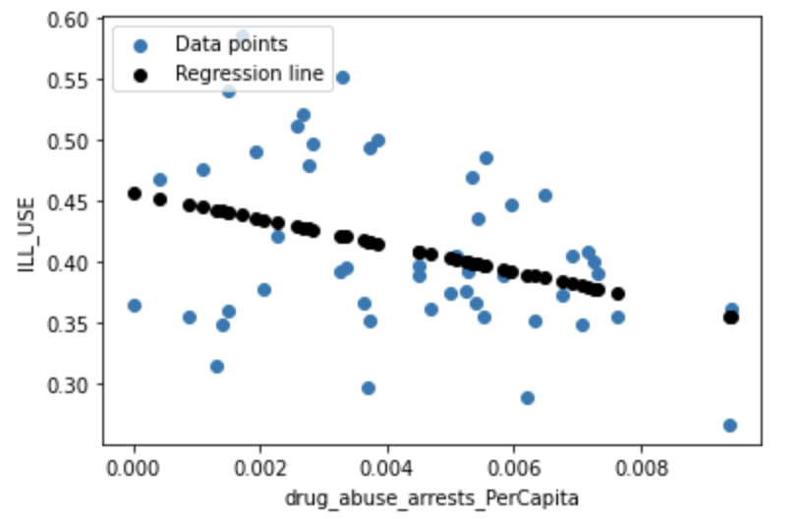
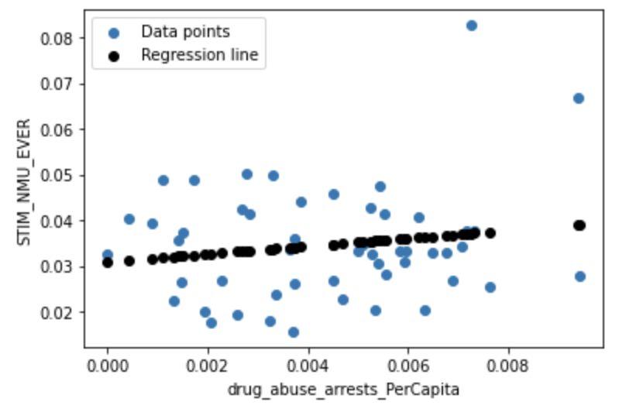
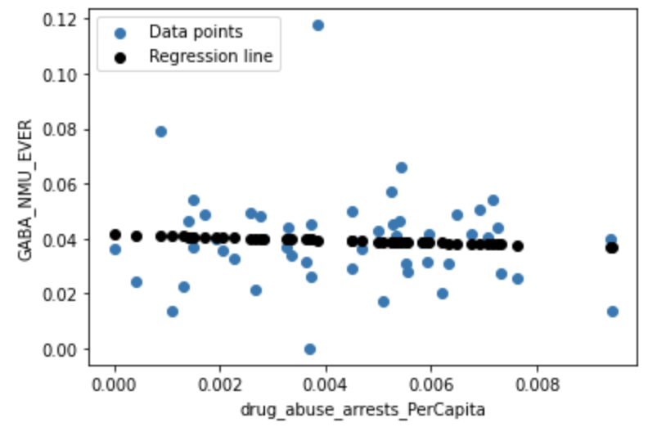
Regression Models for Drug Arrests VS Drugs
No significant p-values at alpha level 0.05
Except for ILL_USE (p<0.011)

Slide 9
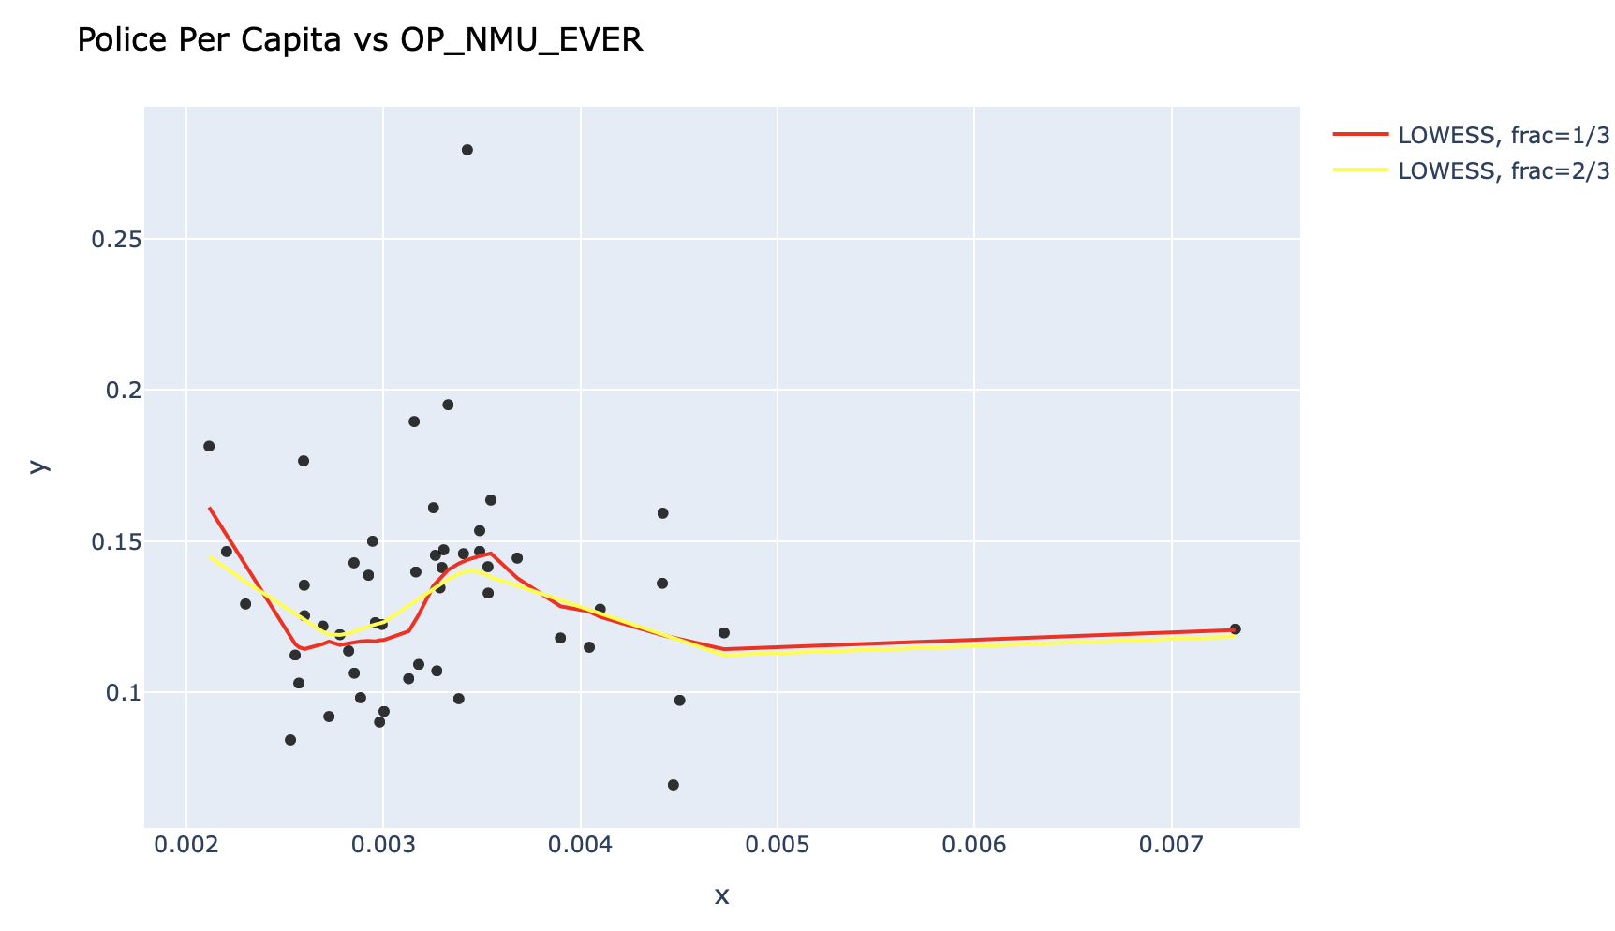
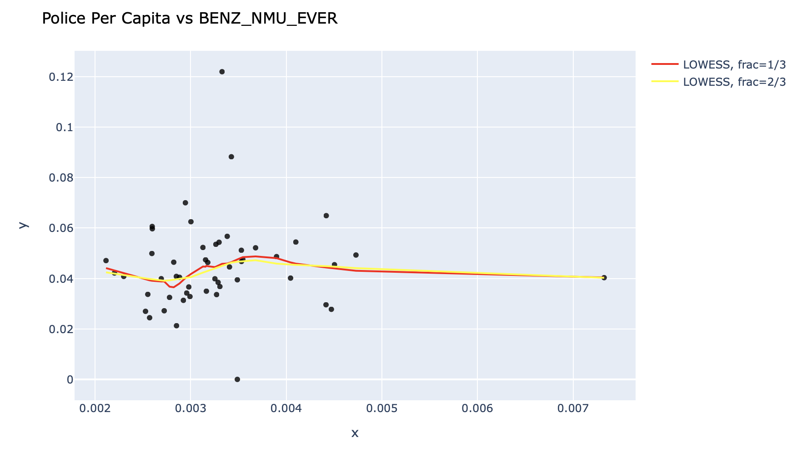
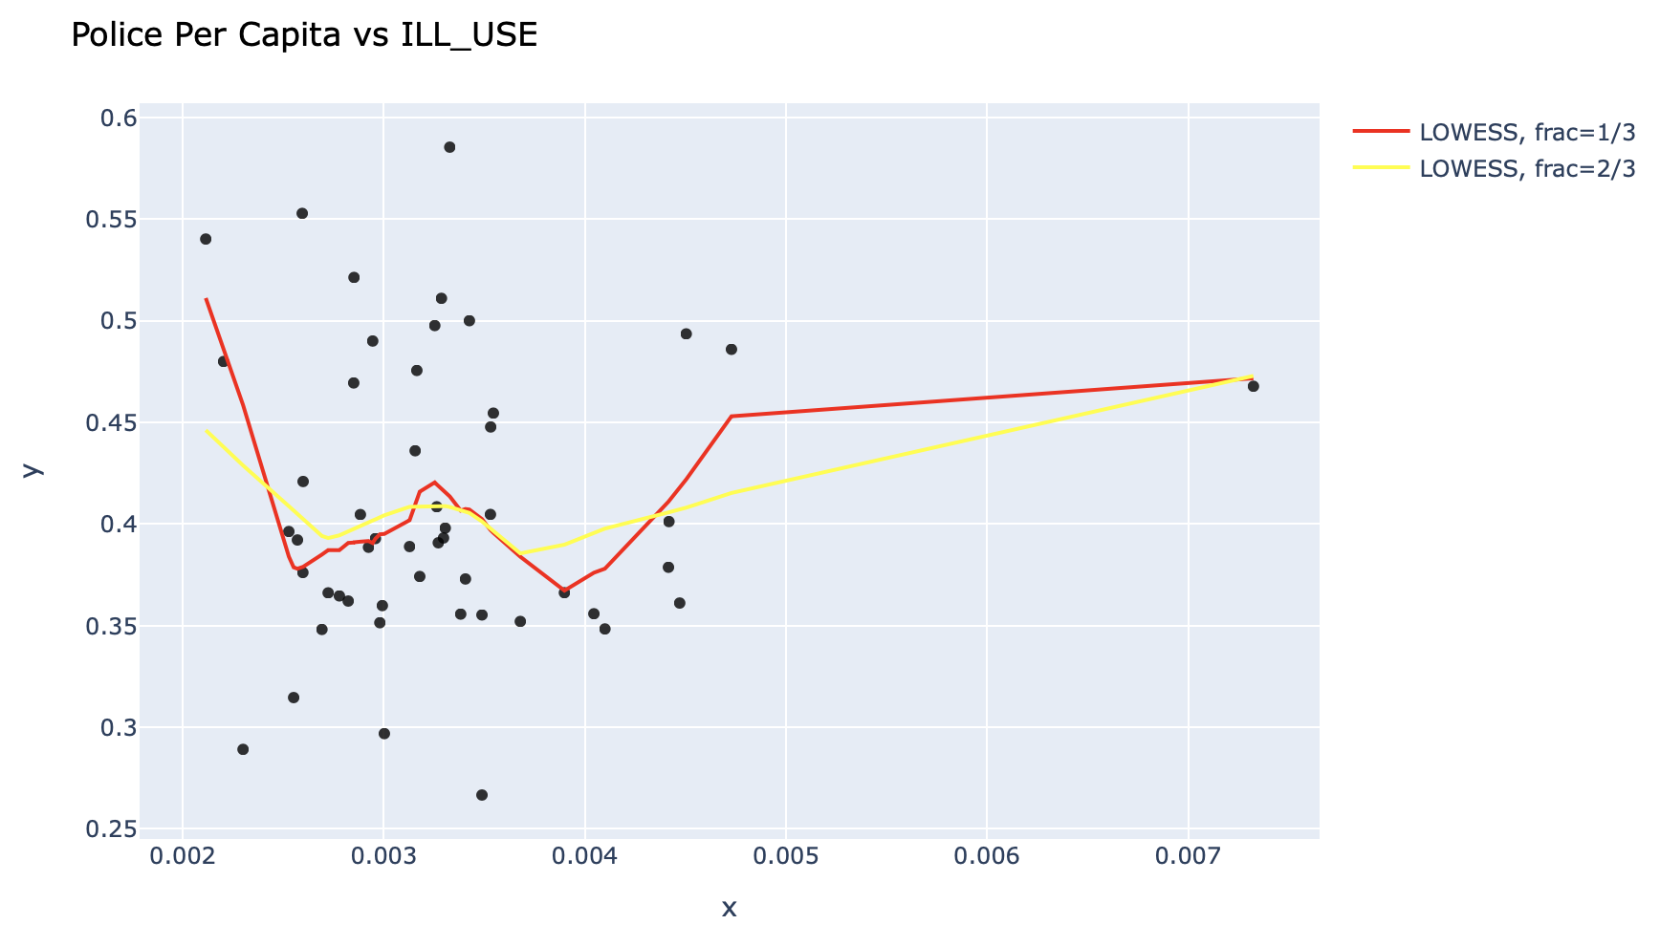
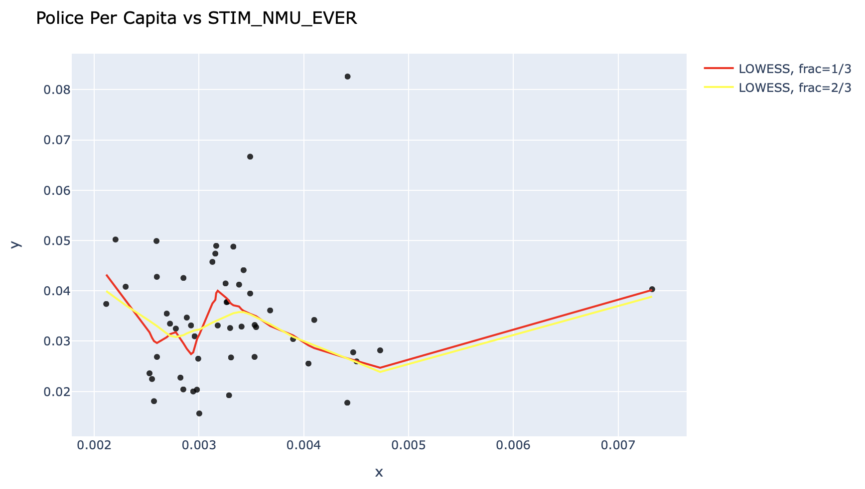
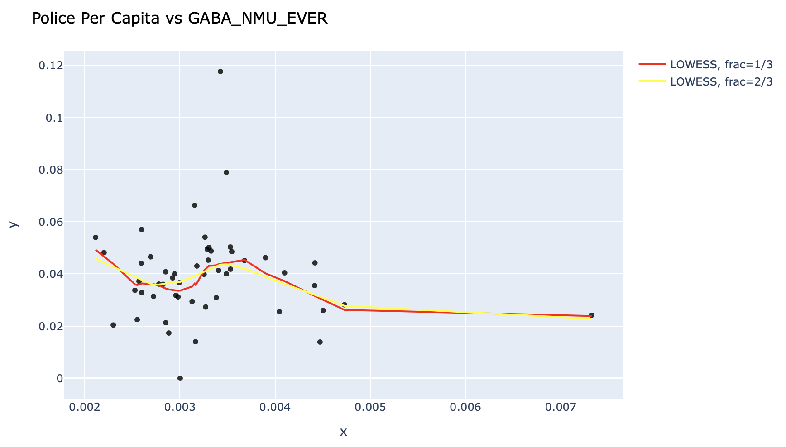
Lowess Smoothing Scatter Plots Police Per Capita
Insignificant nonlinearity

Slide 10
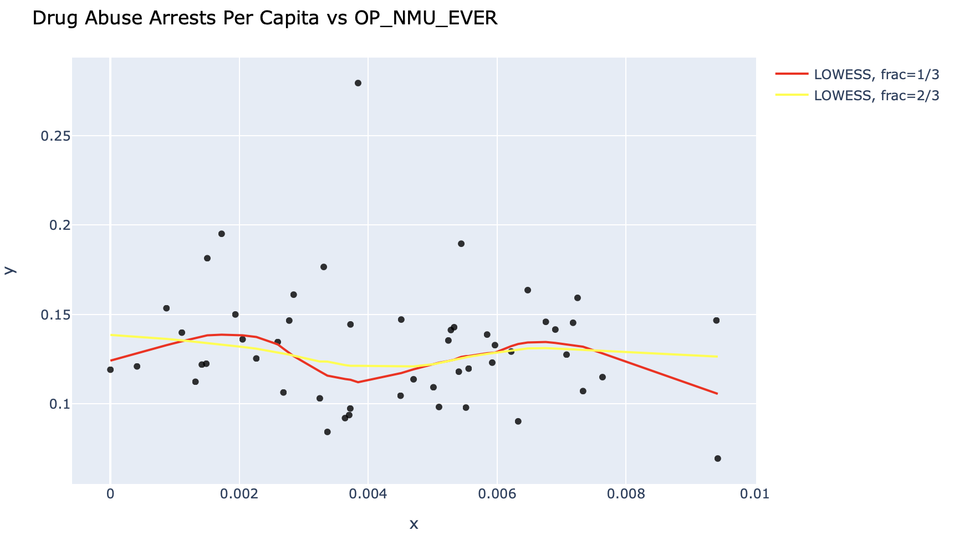
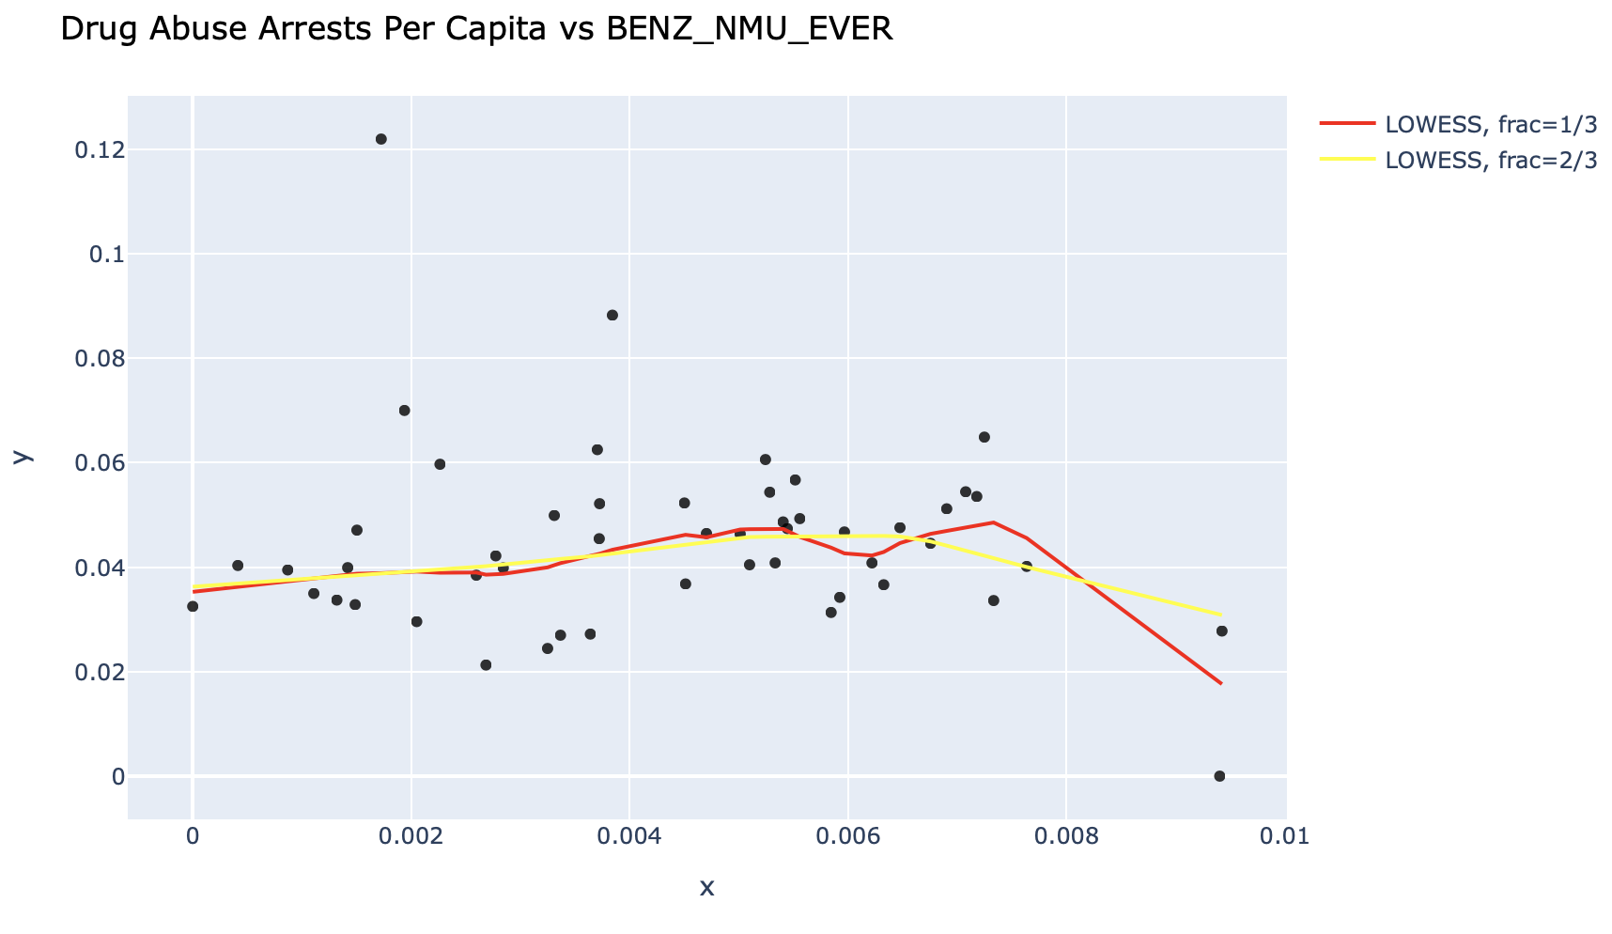
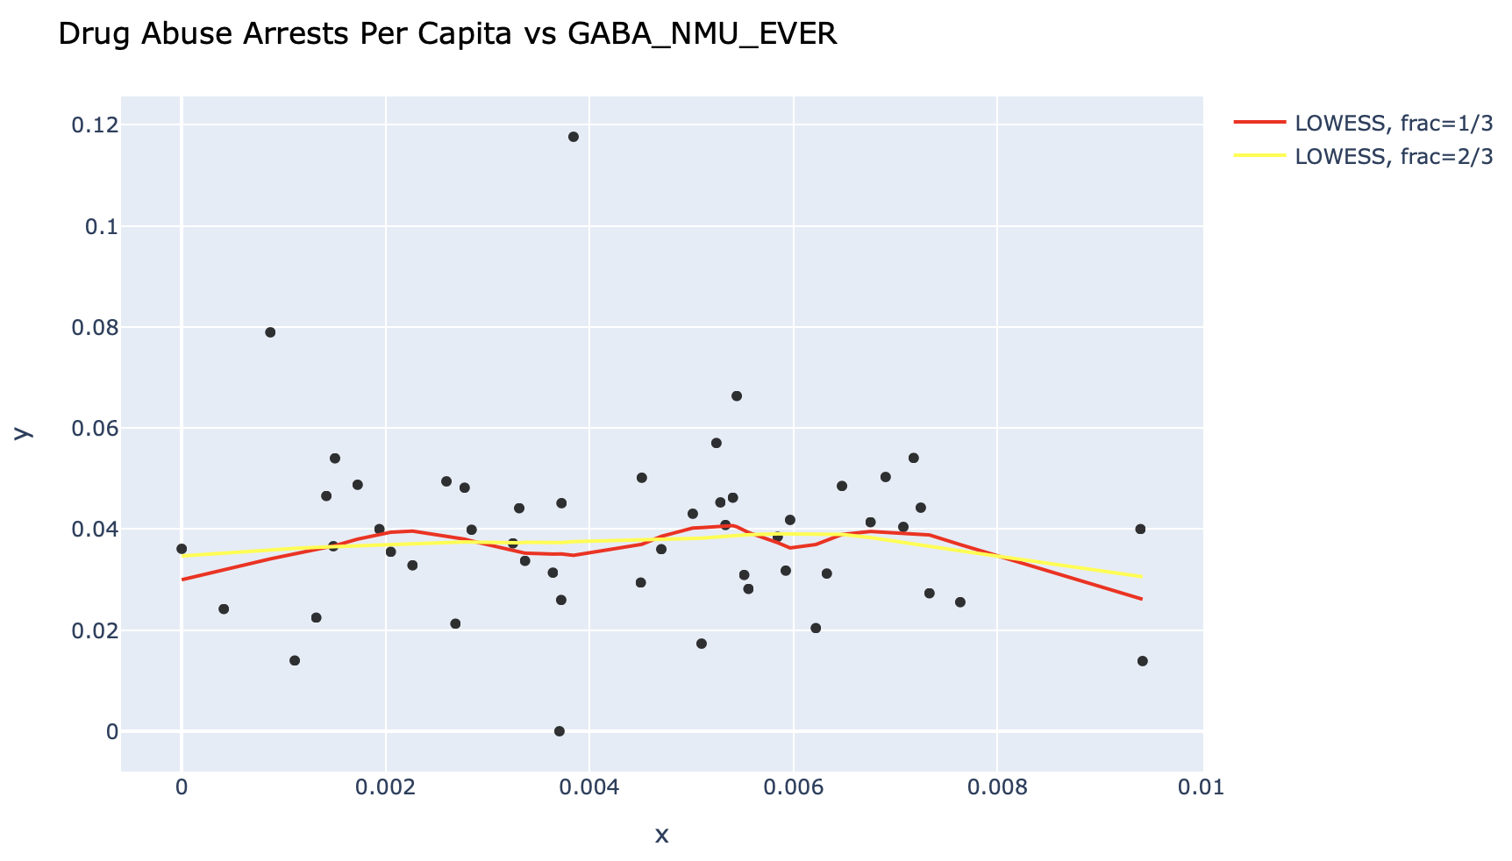
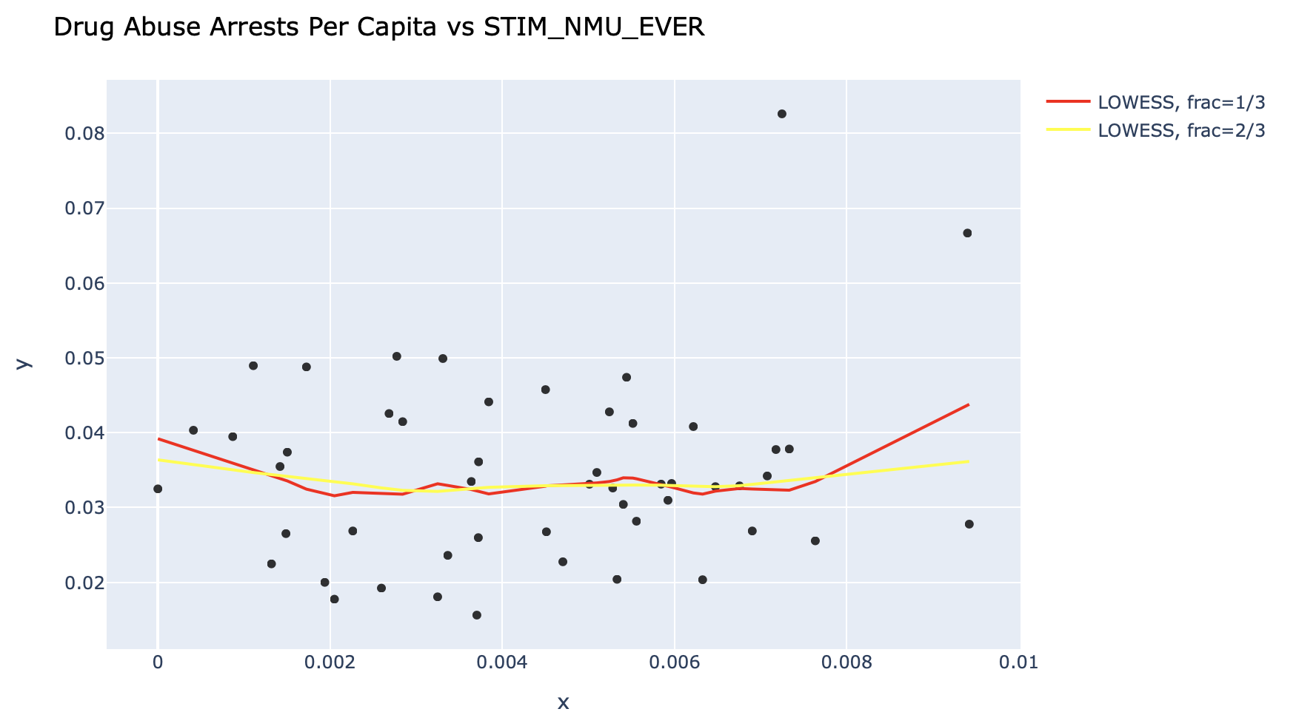
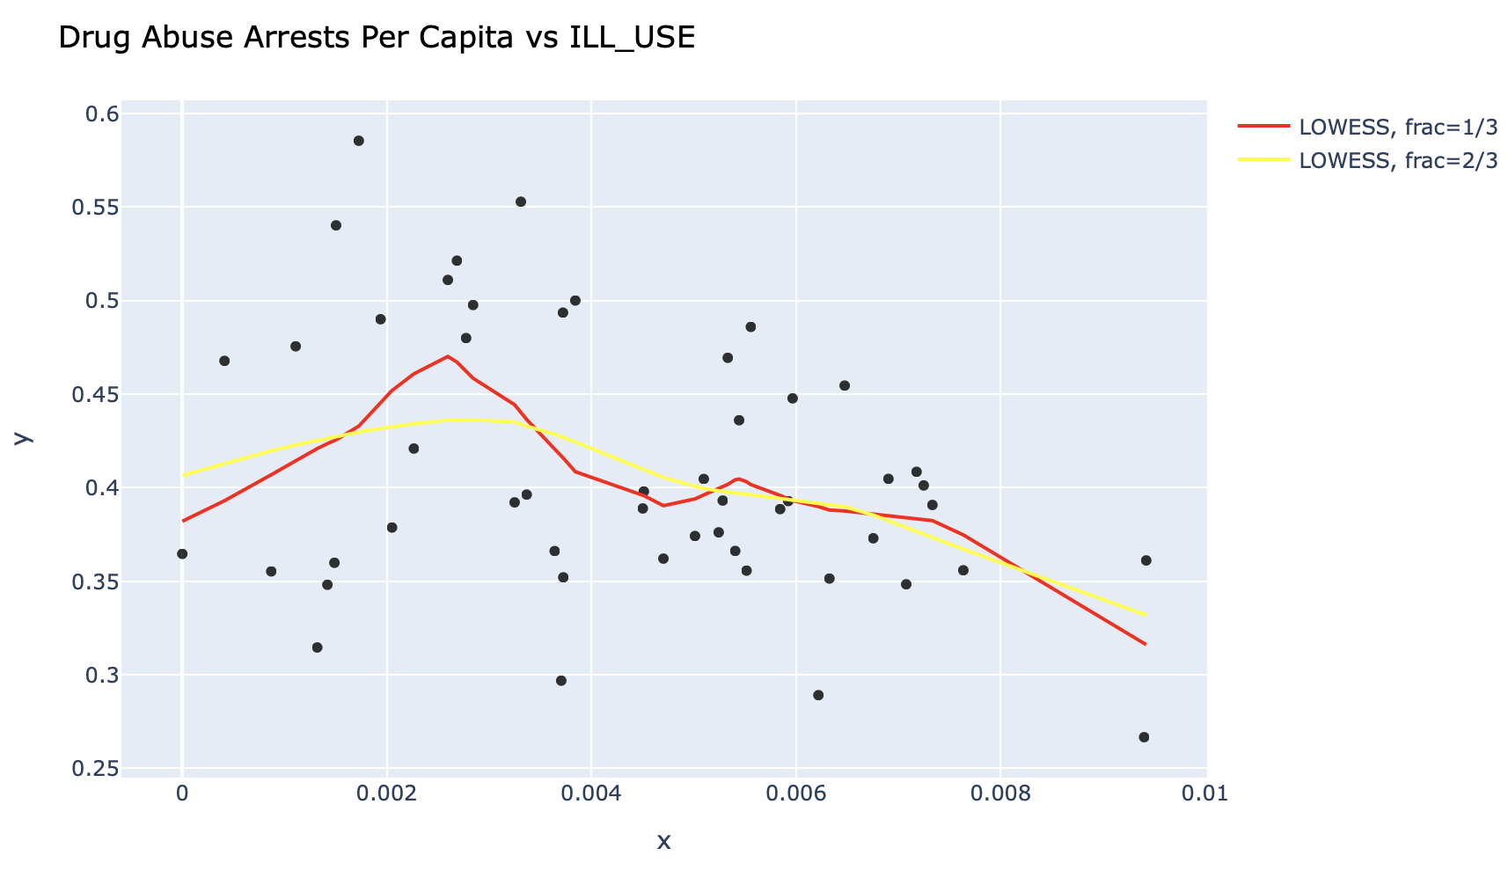
Lowess Smoothing Scatter Plots Arrests Per Capita
Insignificant nonlinearity

Slide 11
Finding #1
Policing and arrests have no impact on recreational drug use

Slide 12
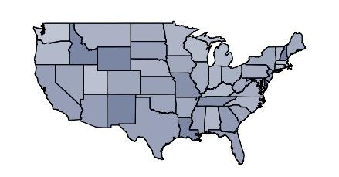
Police Density by State
Top 3 States
1. Delaware
2. New Hampshire
3. New Mexico

Slide 13
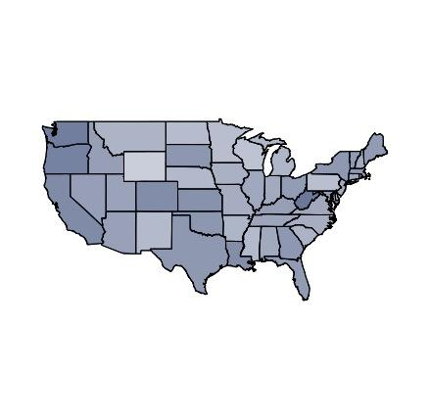
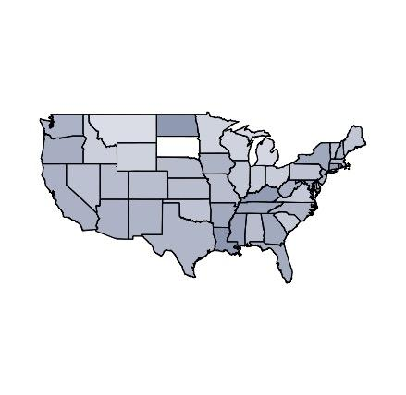
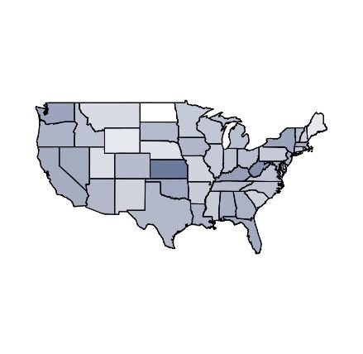
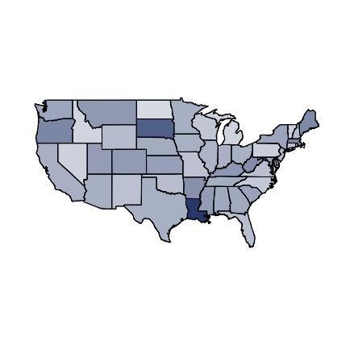
Density of Recreational Drug Use by State
Opioids
Benzodiazepine
GABA-analogue
Stimulants

Slide 14
Density of Recreational Drug Use (Opioids) by State
States with Highest Opioid Use
States with Lowest Opioid Use
Louisiana
Ranks #5 in Police Density
Washington
Ranks #50 in Police Density
New Mexico
Ranks #3 in Police Density
Wisconsin
Ranks #46 in Police Density
Notes:
New Mexico
3rd Highest Police Density, 6th Lowest Opioid Use
Louisiana
5th Highest Police Density, 8th Highest Opioid
Find lowest police density states, one with high OP one with low OP
Washington
1st Lowest Police Density, 4th Highest Opiod Use
Wisconsin
4th Lowest Police Density, 2nd Lowest Opioid Use

Slide 15
Finding #2
Higher policing is associated with reduced illegal drug use

Slide 16
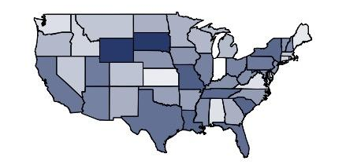
Map of Drug Abuse Arrests
Top 3 States
1. Wyoming
2. South Dakota
3. Missouri

Slide 17
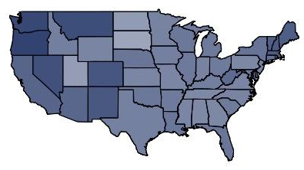
Density of Illicit Drug Use by State
States with Highest Illicit Drug Use
States with Lowest Illicit Drug Use
Washington
Ranks #3 in Illicit Drug Use
Ranks # 42 in Drug Abuse Arrests
South Dakota
Ranks #50 in Illicit Drug Use
Ranks #2 in Drug Abuse Arrests
Notes:
INVERSE RELATIONSHIP

Slide 18
Overall Finding
Recreational drug use has no correlation with police density

Slide 19
Works Cited
“Table 69.” FBI, FBI, 12 Sept. 2019,
ucr.fbi.gov/crime-in-the-u.s/2018/crime-in-the-u.s.-2018/tables/table-69.
“Table 77.” FBI, FBI, 7 Aug. 2019,
ucr.fbi.gov/crime-in-the-u.s/2018/crime-in-the-u.s.-2018/tables/table-77.

